Slide 1
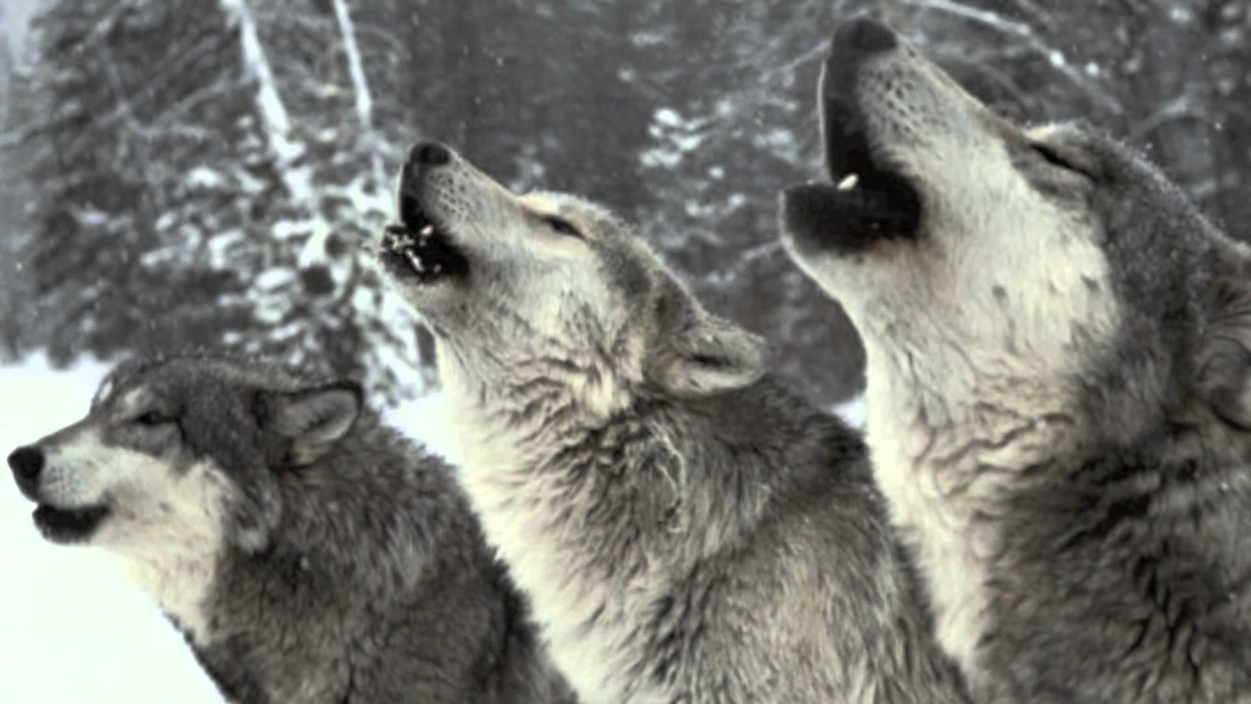
Introducing our new PACK members

Slide 2
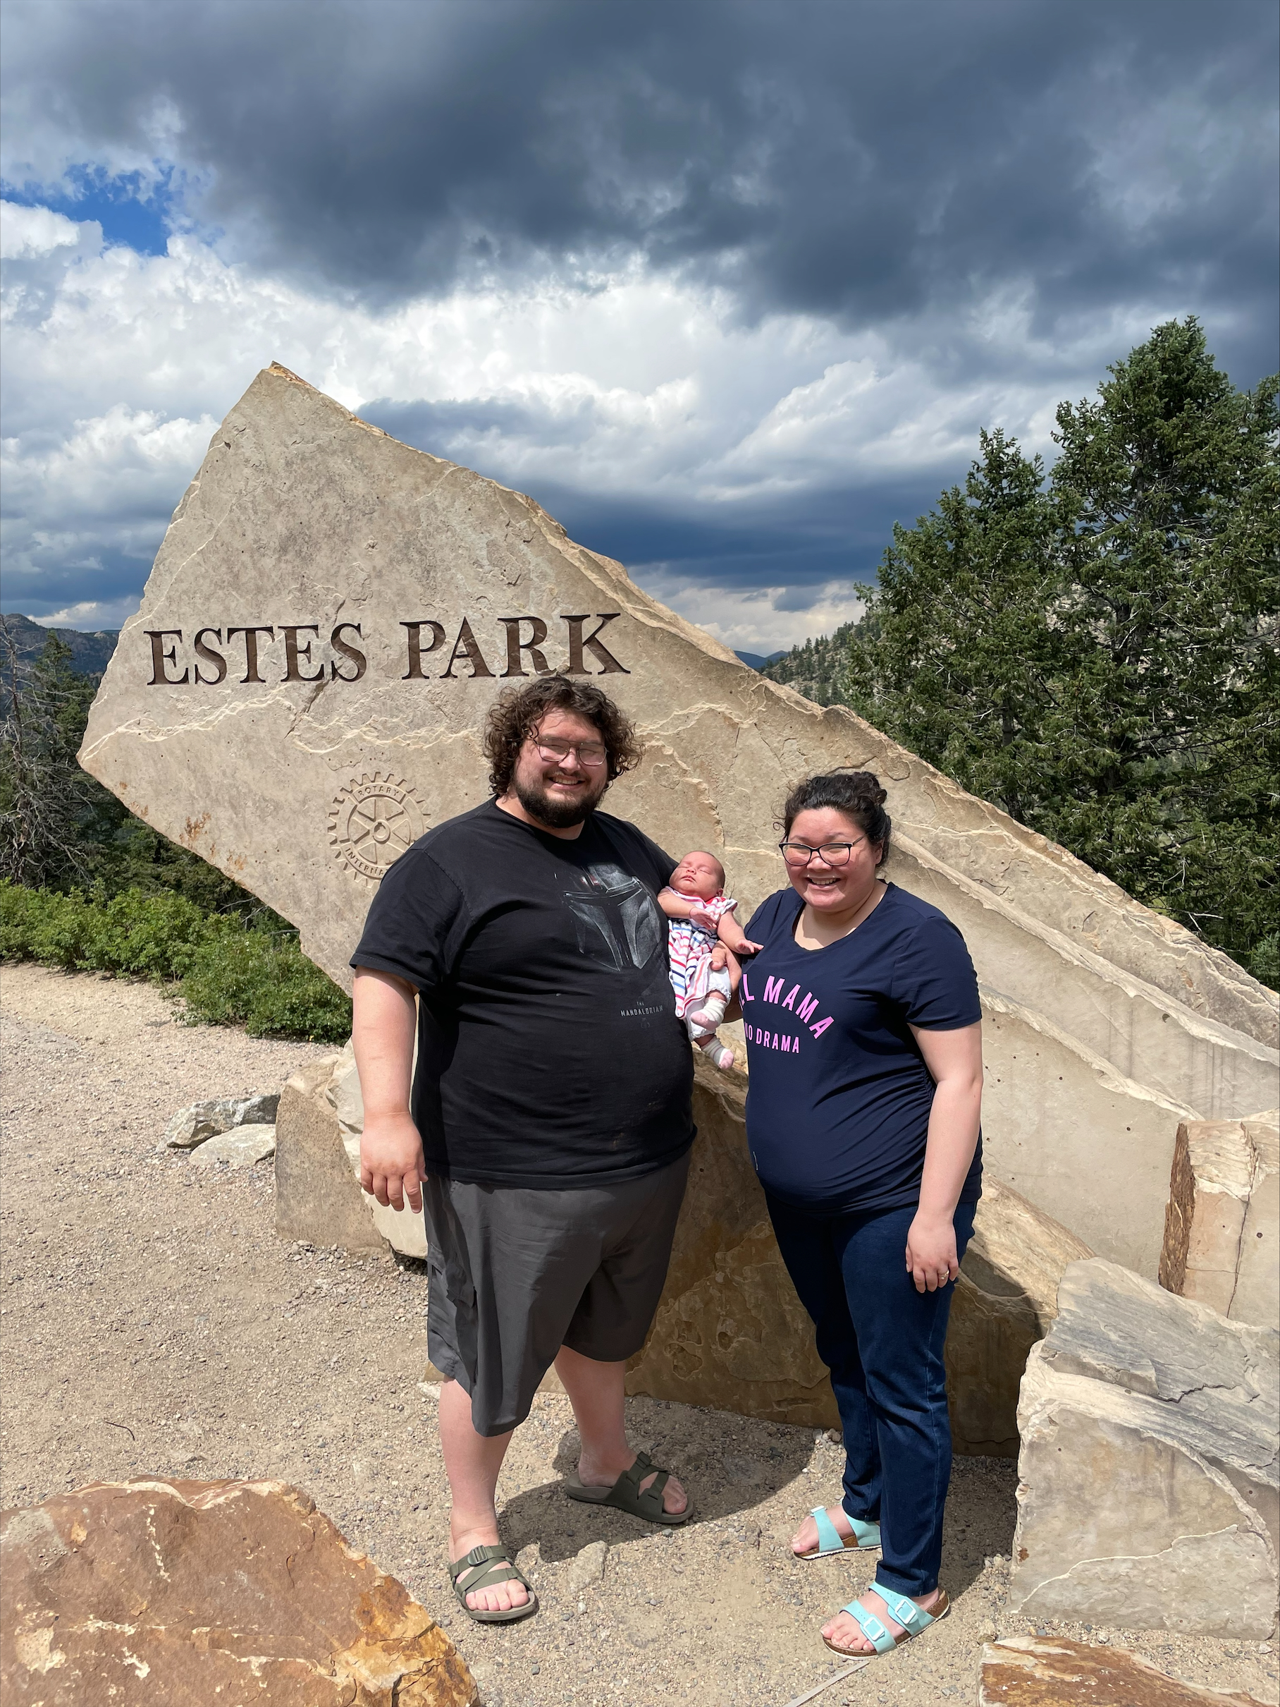
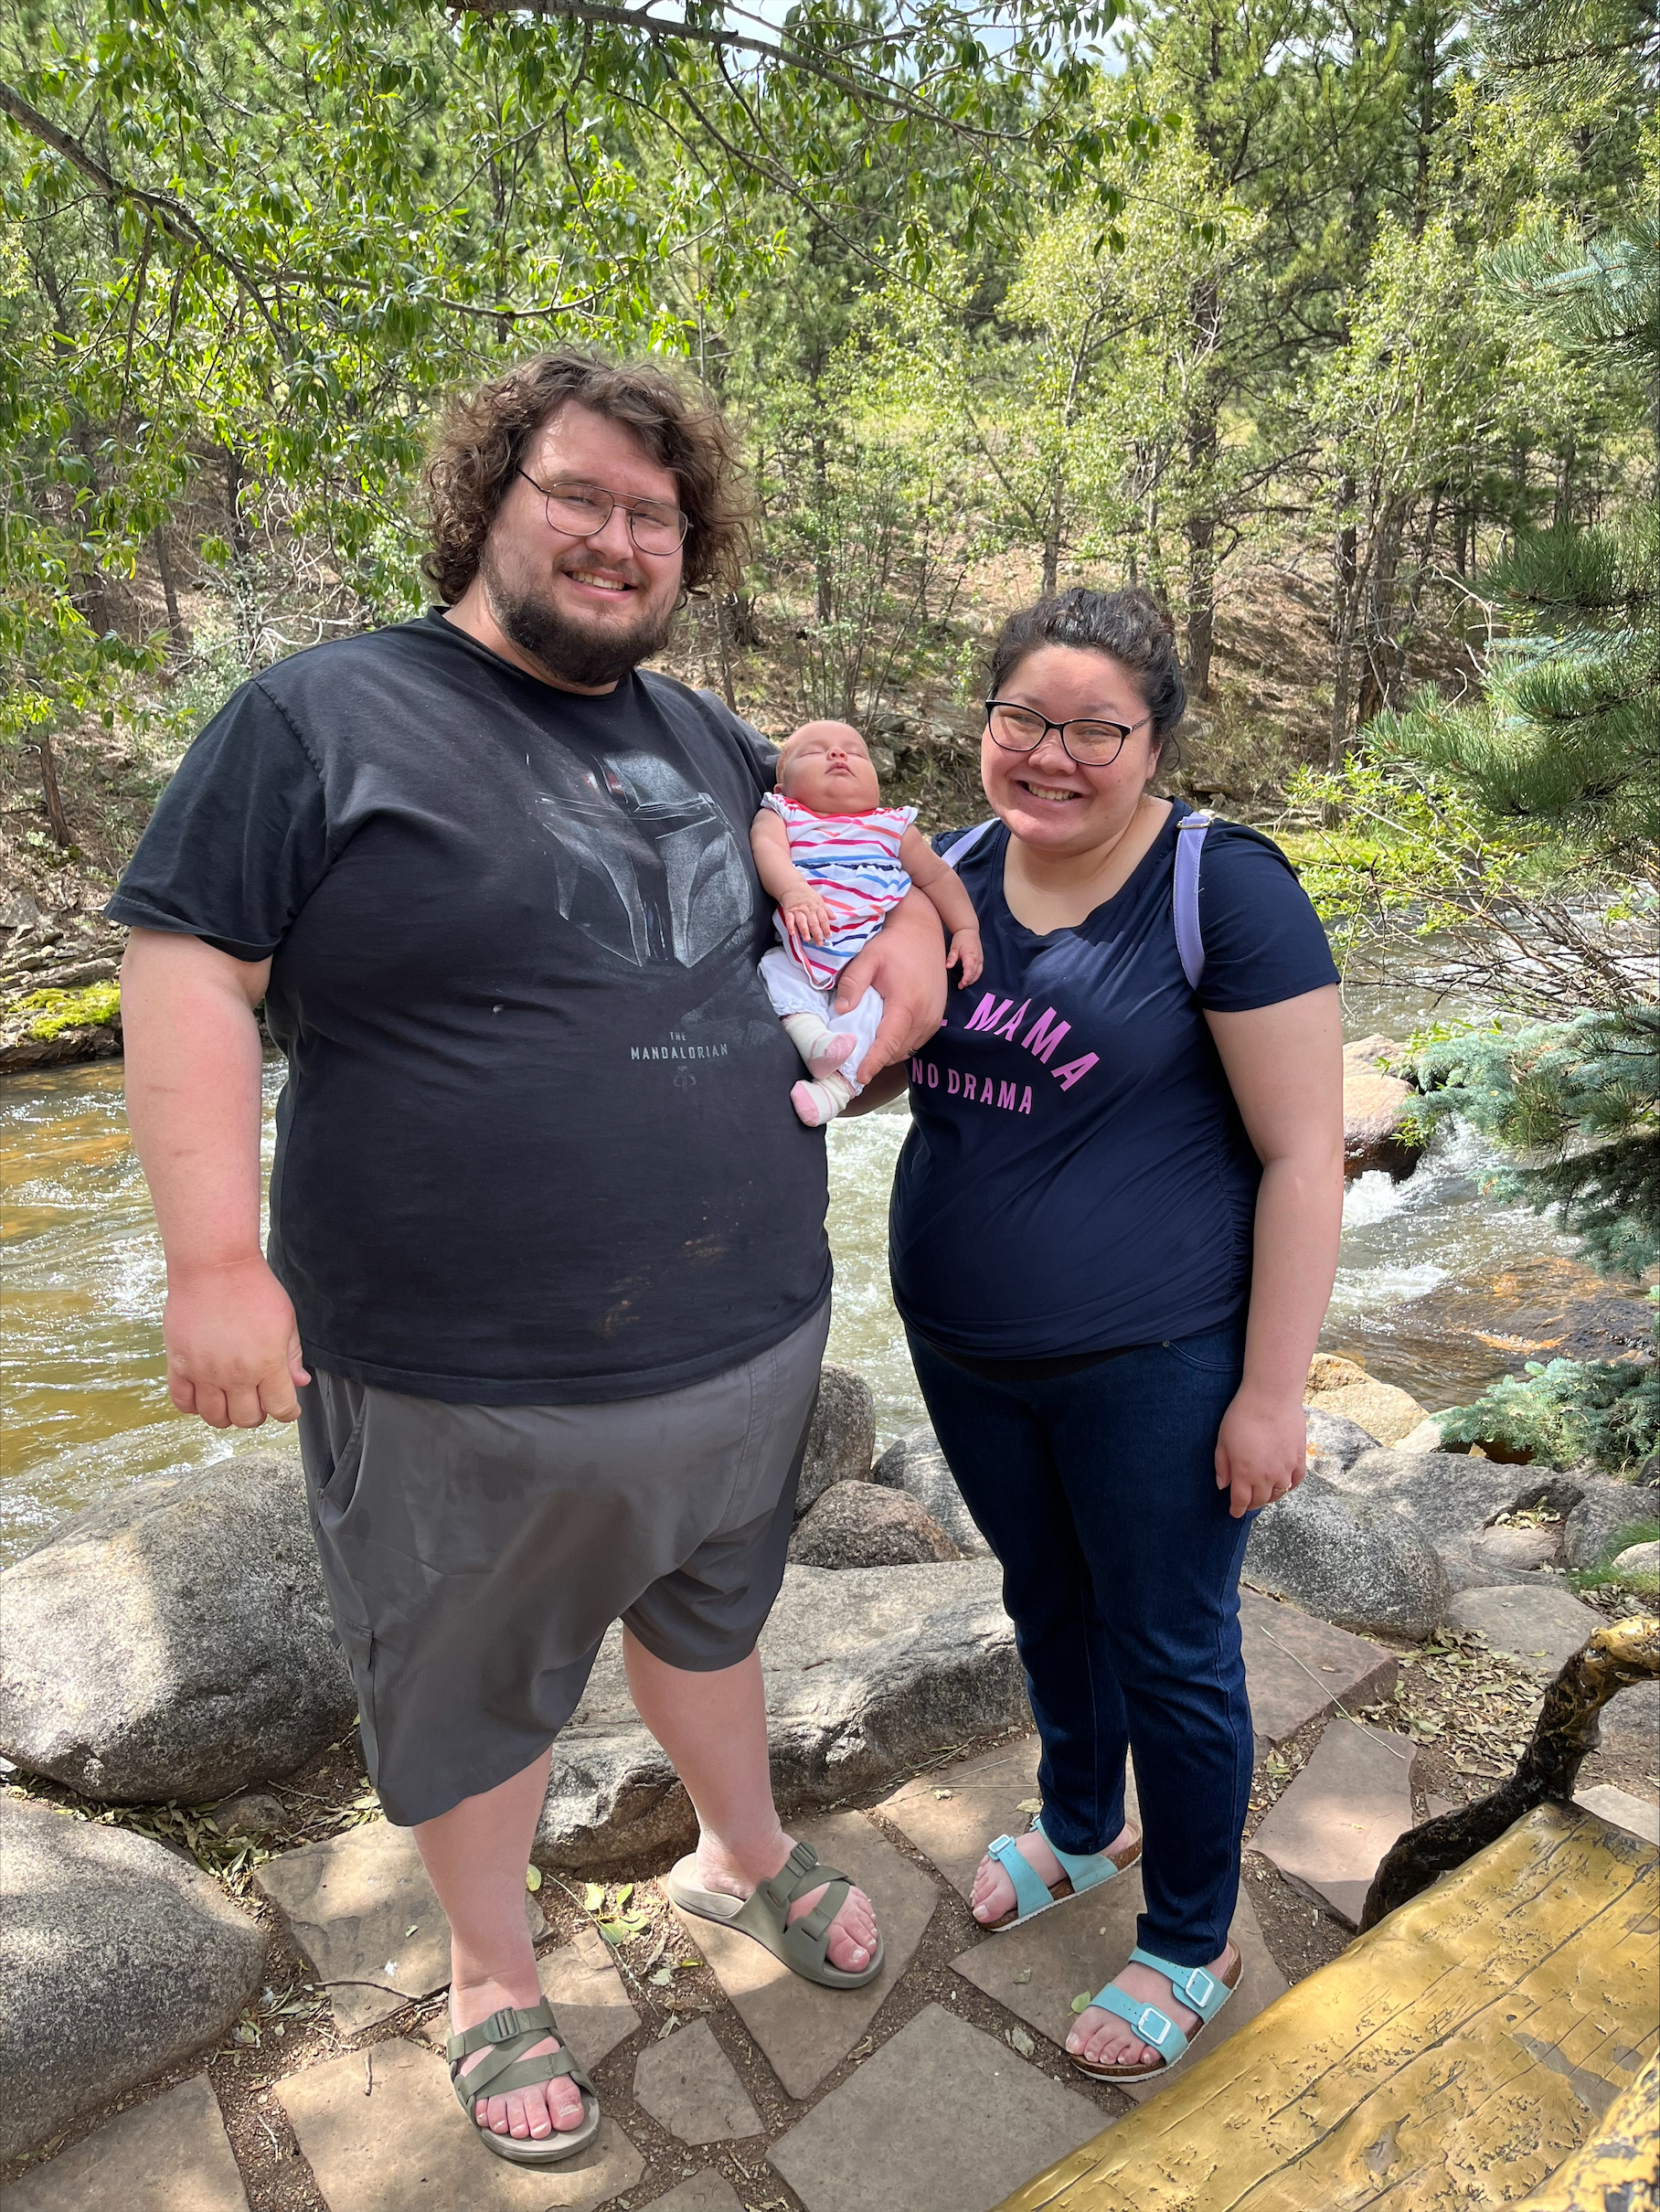
Alexander Chopyak - Math
I am coming from 6 years at Kentlake High School in the Kent School District.
I am very excited about the community that I have seen so far. I am excited for the students that I will be working with and building the new relationship with these students.
My why in teaching is because there are many students that need the support or the mentorship or the role models. As a teacher we are here to help these students to not just be learners for now but learners for life. We are part of their journey and need to help guide students into the next stage of their life whether it is a 2 year school, a tech school, a college, or just working.

Slide 3
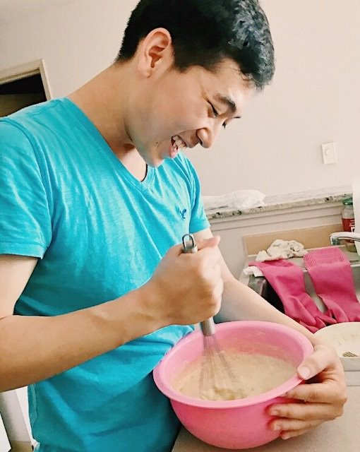
Brian Lim - Math
I started teaching 3 years ago right when COVID hit and was at Insight School of Washington in Quillayute School District (Tacoma)
I remember during my interview I read the newsletter and other than it looks amazing, I got to see a lot of student involvement and was really impressed by it. I am also extremely excited about the math curriculum since I was so used to creating my own materials for math, so this will be very new for me!
A huge part of the reason why I enjoy what I do is fostering those student relationships and want to help students understand that math is not as scary as some might think and is more applicable than they think it is used for.

Slide 4
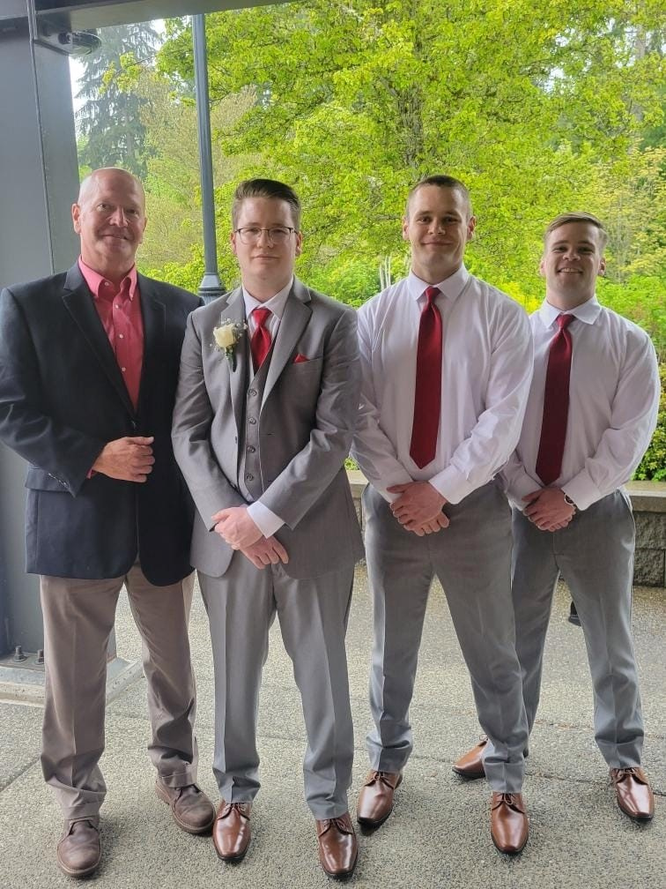
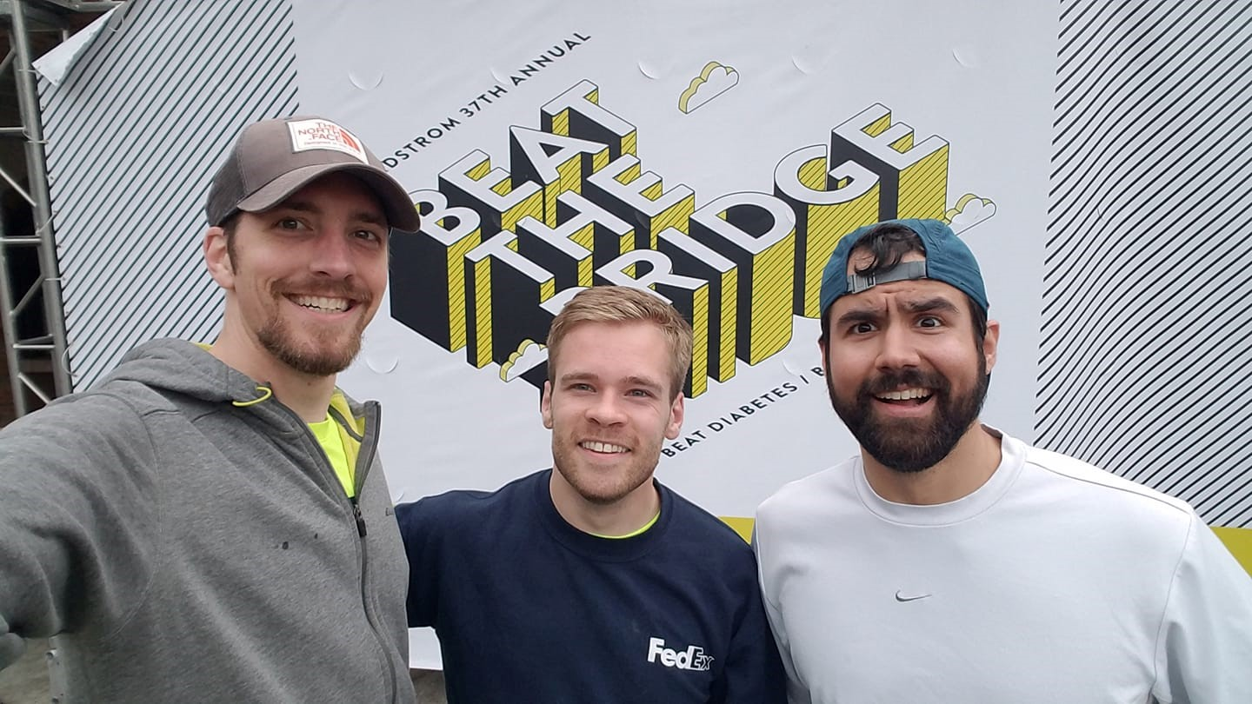
Garret Pope - Math
I am coming to JHS from Lake Stevens HS. I am originally from Machias, WA.
I am excited to work at Jackson because everyone I've met so far seems absolutely awesome. In my short time here, I have met many folks who clearly love kids, love their jobs, and love their community.
My WHY is simply that I know that I'm supposed to be a teacher. From a pretty young age I felt called to teach and I don't think there's anything else that I would want to do.

Slide 5
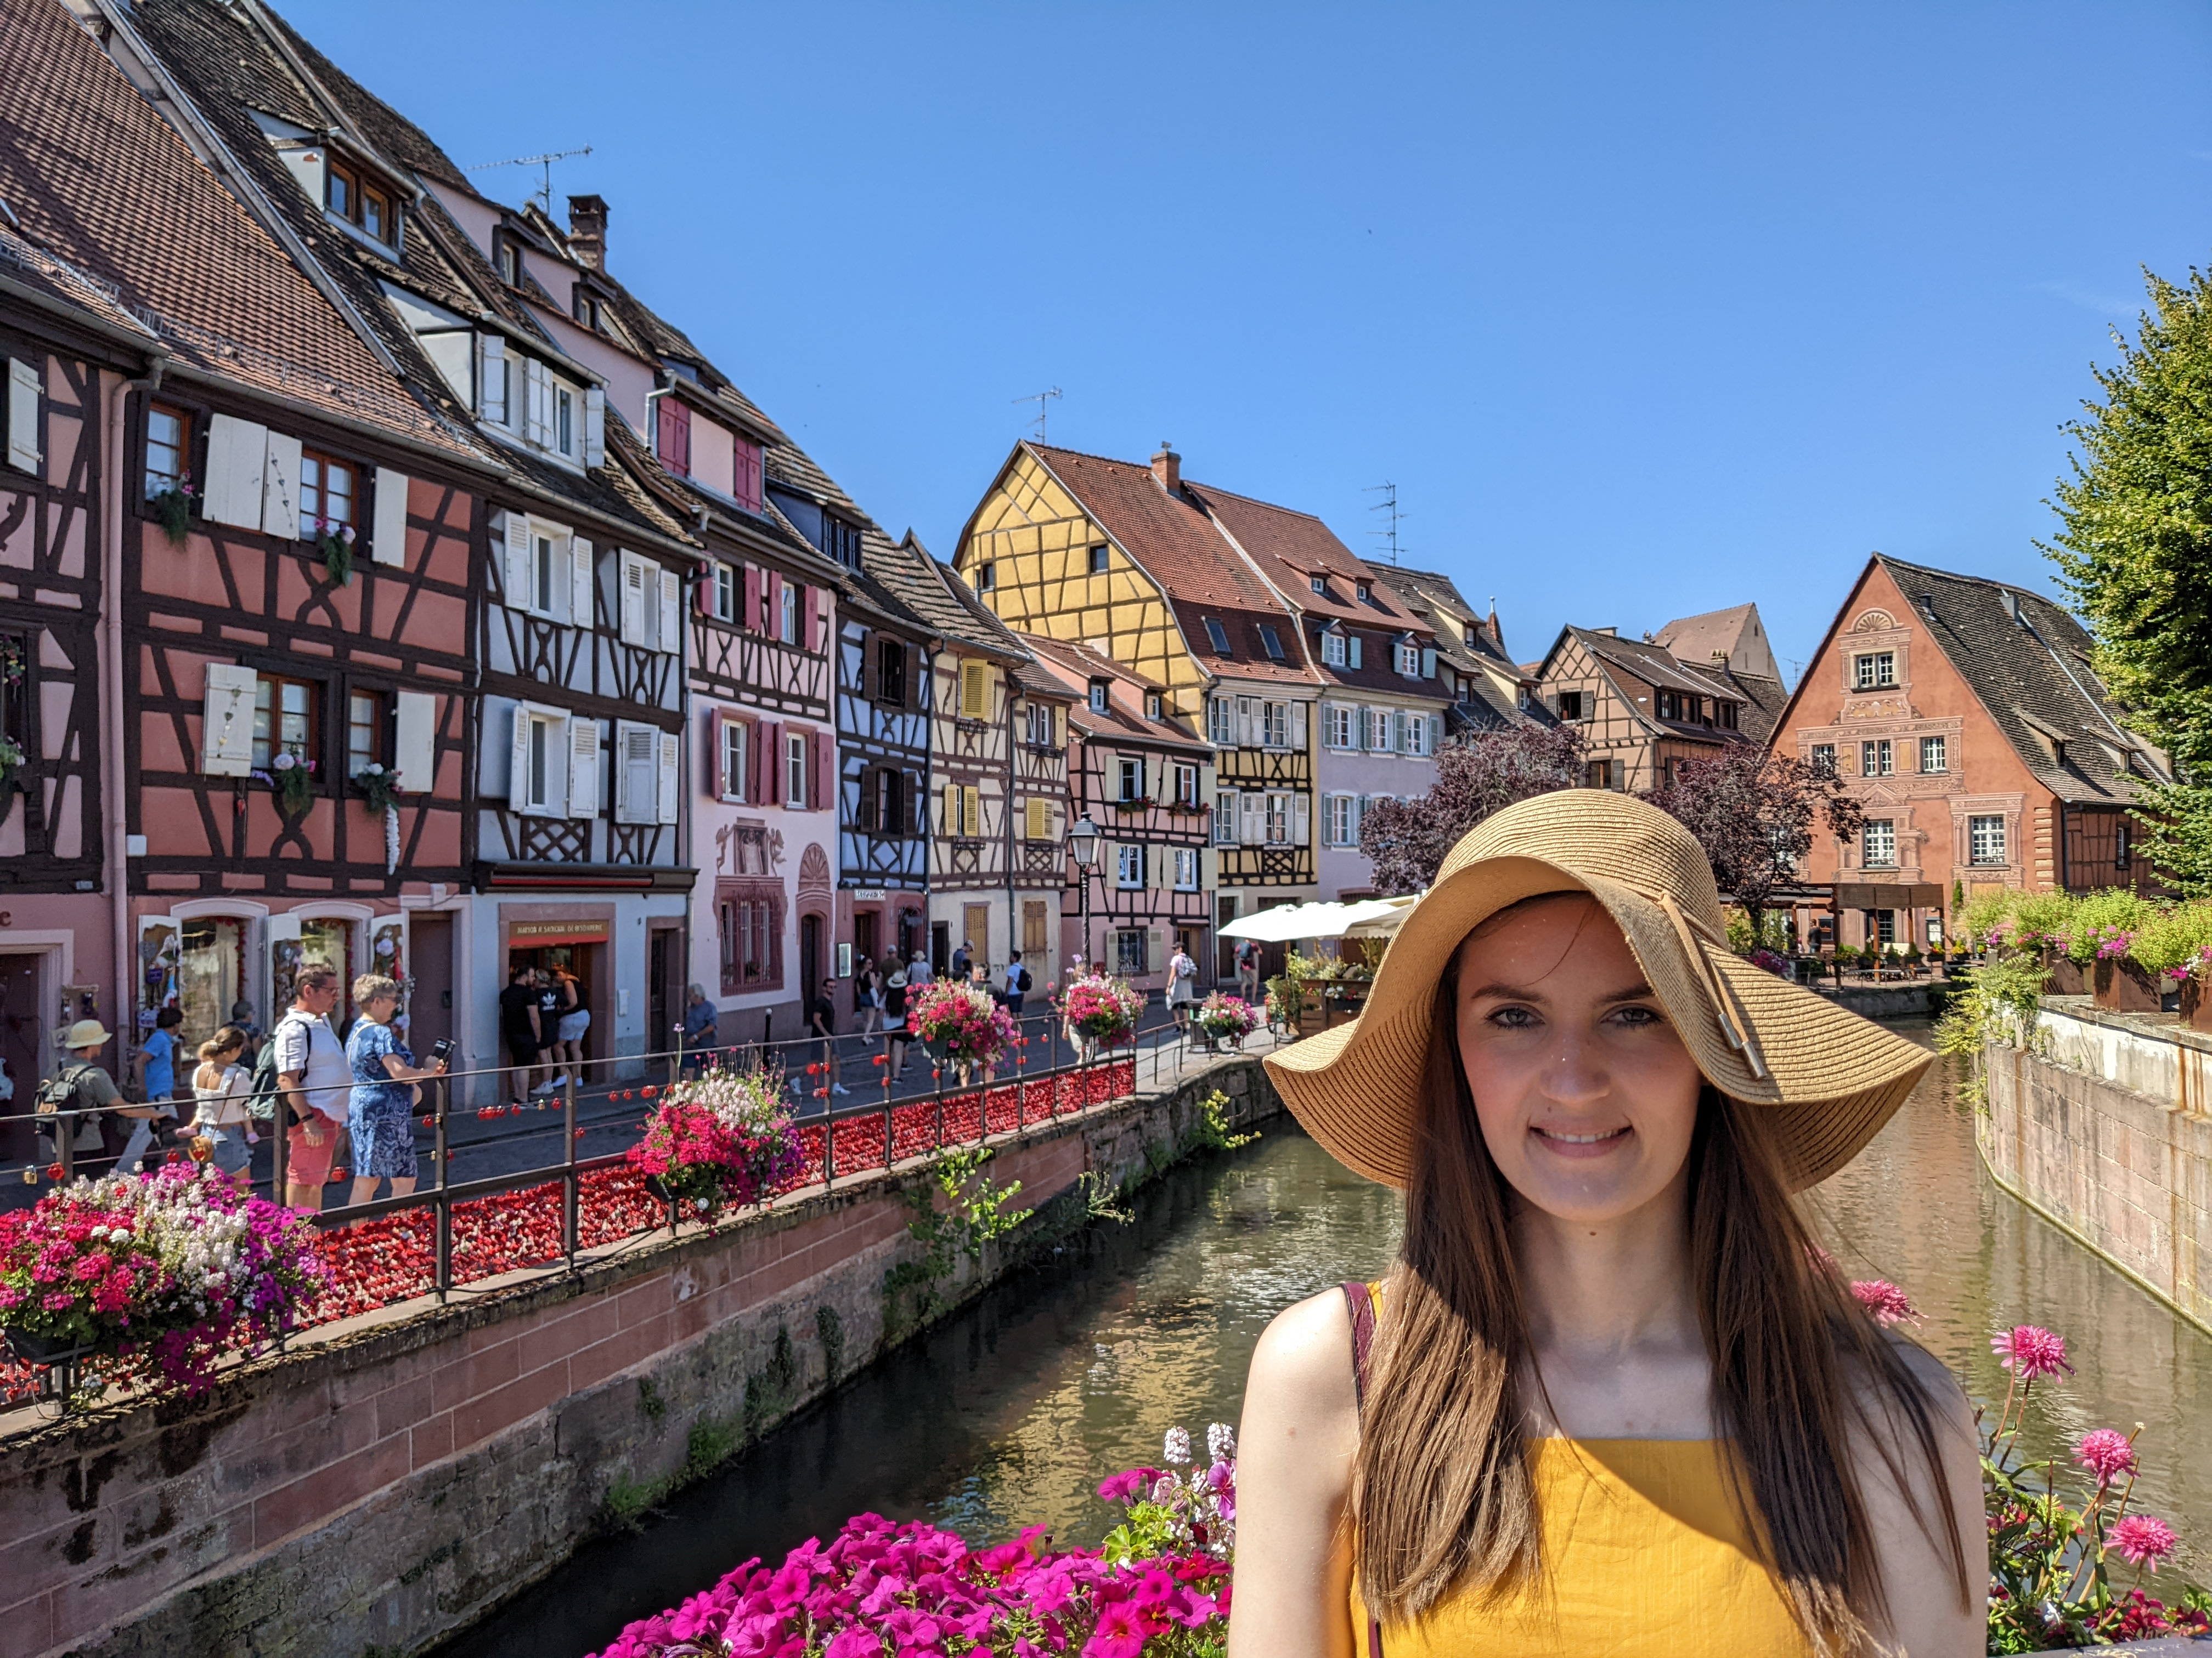
Alina Bryenton – World Languages (German)
I’m coming from EHS, where I taught ML students for 2 years.
I look forward to sharing my native language, German.
Education opens doors and offers opportunities for growth!

Slide 6
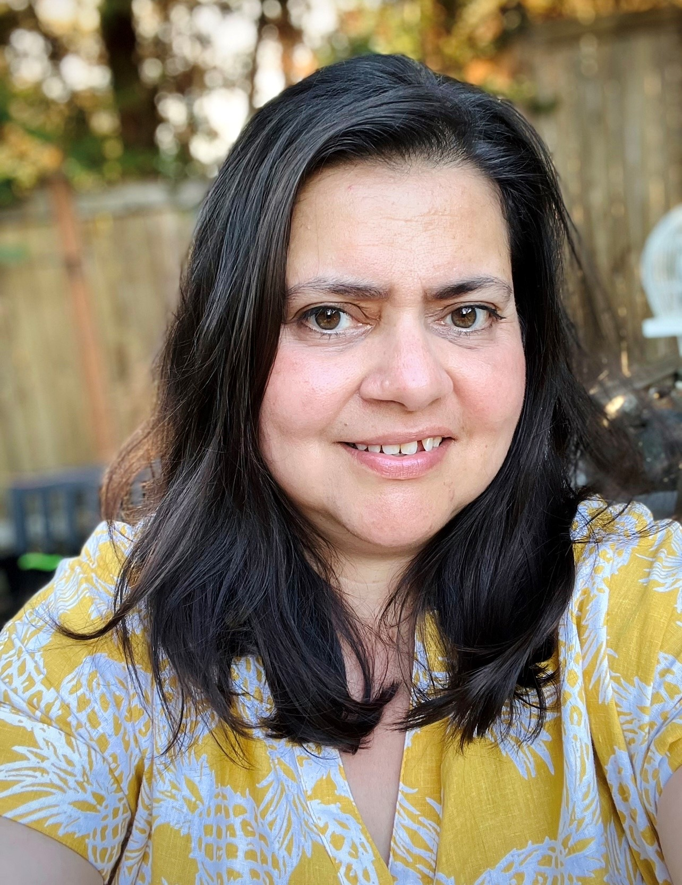
Claudia Childers – ML Success Coordinator
Before Jackson I was the MLL para at Silverlake Elementary
I am excited about joining JHS because I get to see some of the students that were in my pre teach groups in elementary. I get to witness how much they have grown, and I get to help kids that feel overwhelmed or lost find a path or at the very least know that they are not traveling alone in their high school journey. Plus it is just a really fun place to be.
My WHY is helping both the kids and the parents is my WHY. It makes my heart feel full to know that I have helped the overwhelmed parents navigate high school, a place that looks overwhelming to them. I help alleviate some of the stress that they may be feeling for both the kids and the parents. I get to connect with kids, I take one thing of the many things that they have to juggle and the sense of relief on their faces is priceless. Seeing that sense of relief in the kids and their families faces makes me happy. I get to help kids get acclimated to a new culture. I get exposed to so many different cultures and different ways of doing things. Just knowing that I played a small part in helping their day better – it’s a great feeling.

Slide 7
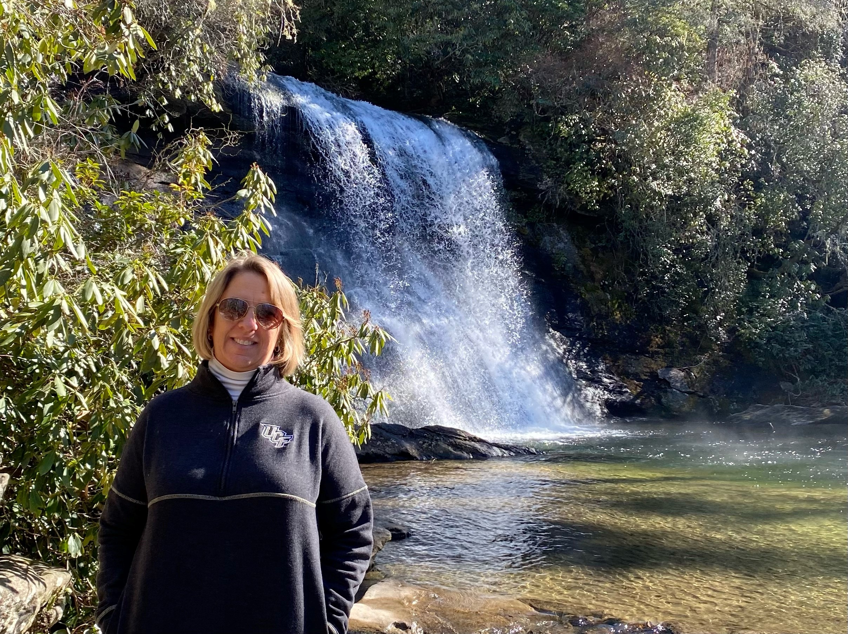
Andrea Hormuth - Counseling
I come from Seminole County in Central Florida
I am excited to join the JHS family as they continue to support students to become the greatest version of themselves.
My WHY is Serving Families-especially those who don't always have the best relationships with education. Doing the right thing for people.

Slide 8
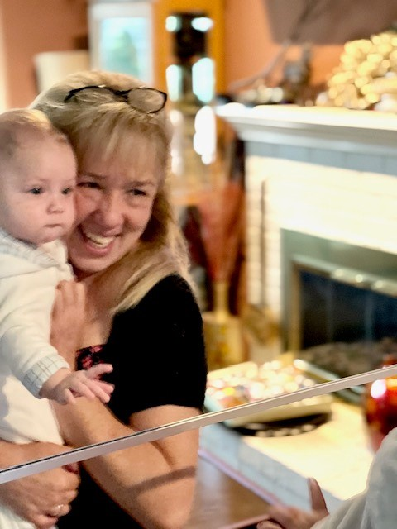
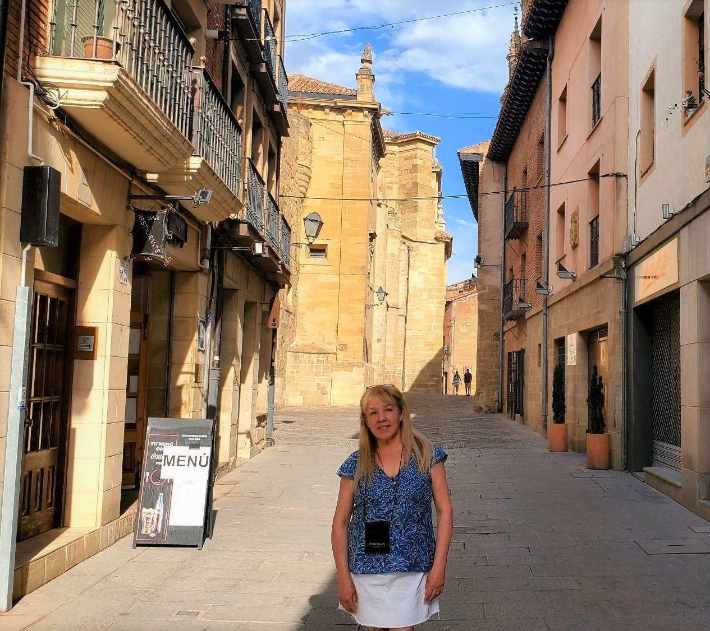
Jessica Montalvo-Lopez – World Languages (Spanish)
I came from Cascade High School
I am excited to join Jackson because I want to be part of the fantastic World Language Team
I feel to teach is an important purpose in my life. I know that for some students, I may be the only person who believes in them, and my classroom is maybe the only safe place they may have. Teaching also allows me to be the link between my students and opportunities that really can change their lives for good. They don’t know what they don’t know. I have 180 days to create a community of learners, thinkers, and problem-solvers. I also have the opportunity to guide them in equity, diversity, and inclusion for them to make a difference. It’s a privilege to have the opportunity to be part of the lives of my students every day.

Slide 9
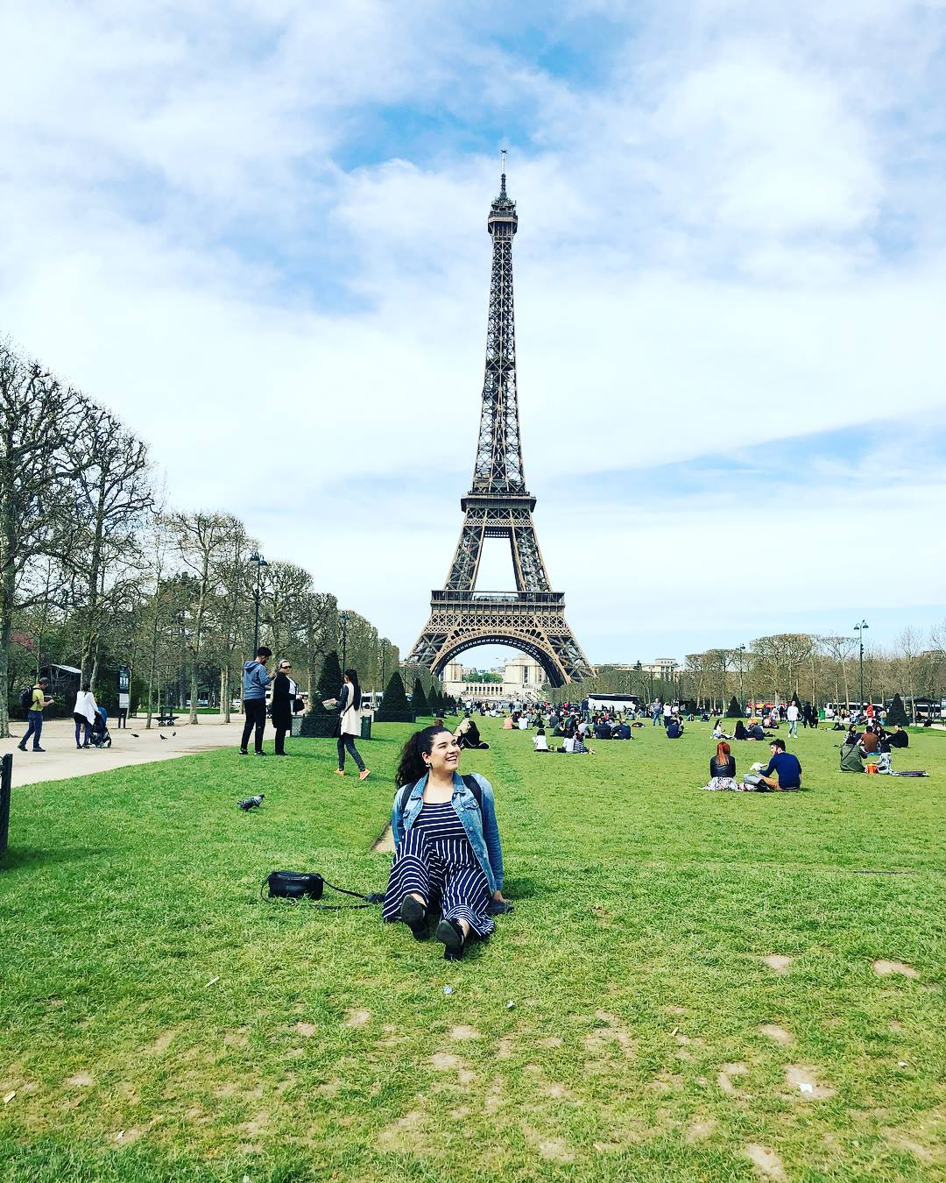
Karla Rios – Counseling Intern
I come to JHS from Brier Terrace Middle School in Edmonds School District. In my previous position, I was a College and Career Readiness Specialist.
Starting my final year in graduate school to obtain my Masters in School Counseling, I am excited to step out of my comfort zone and grow within the Jackson community. In knowing that there is so much knowledge embedded within the school, I am excited to learn through a comprehensive school counseling model to become an effective school counselor. Also, the school counseling team at Jackson is one of a kind!
As a student alumna from the Everett Public Schools, my why stems from being community built and driven. As a first generation Mexican American, navigating a foreign educational system had many obstacles for my family and I. In wanting to serve my community, create opportunities for students and families, and provide tools for post-secondary options is ultimately what motivates and drives the work I do.

Slide 10
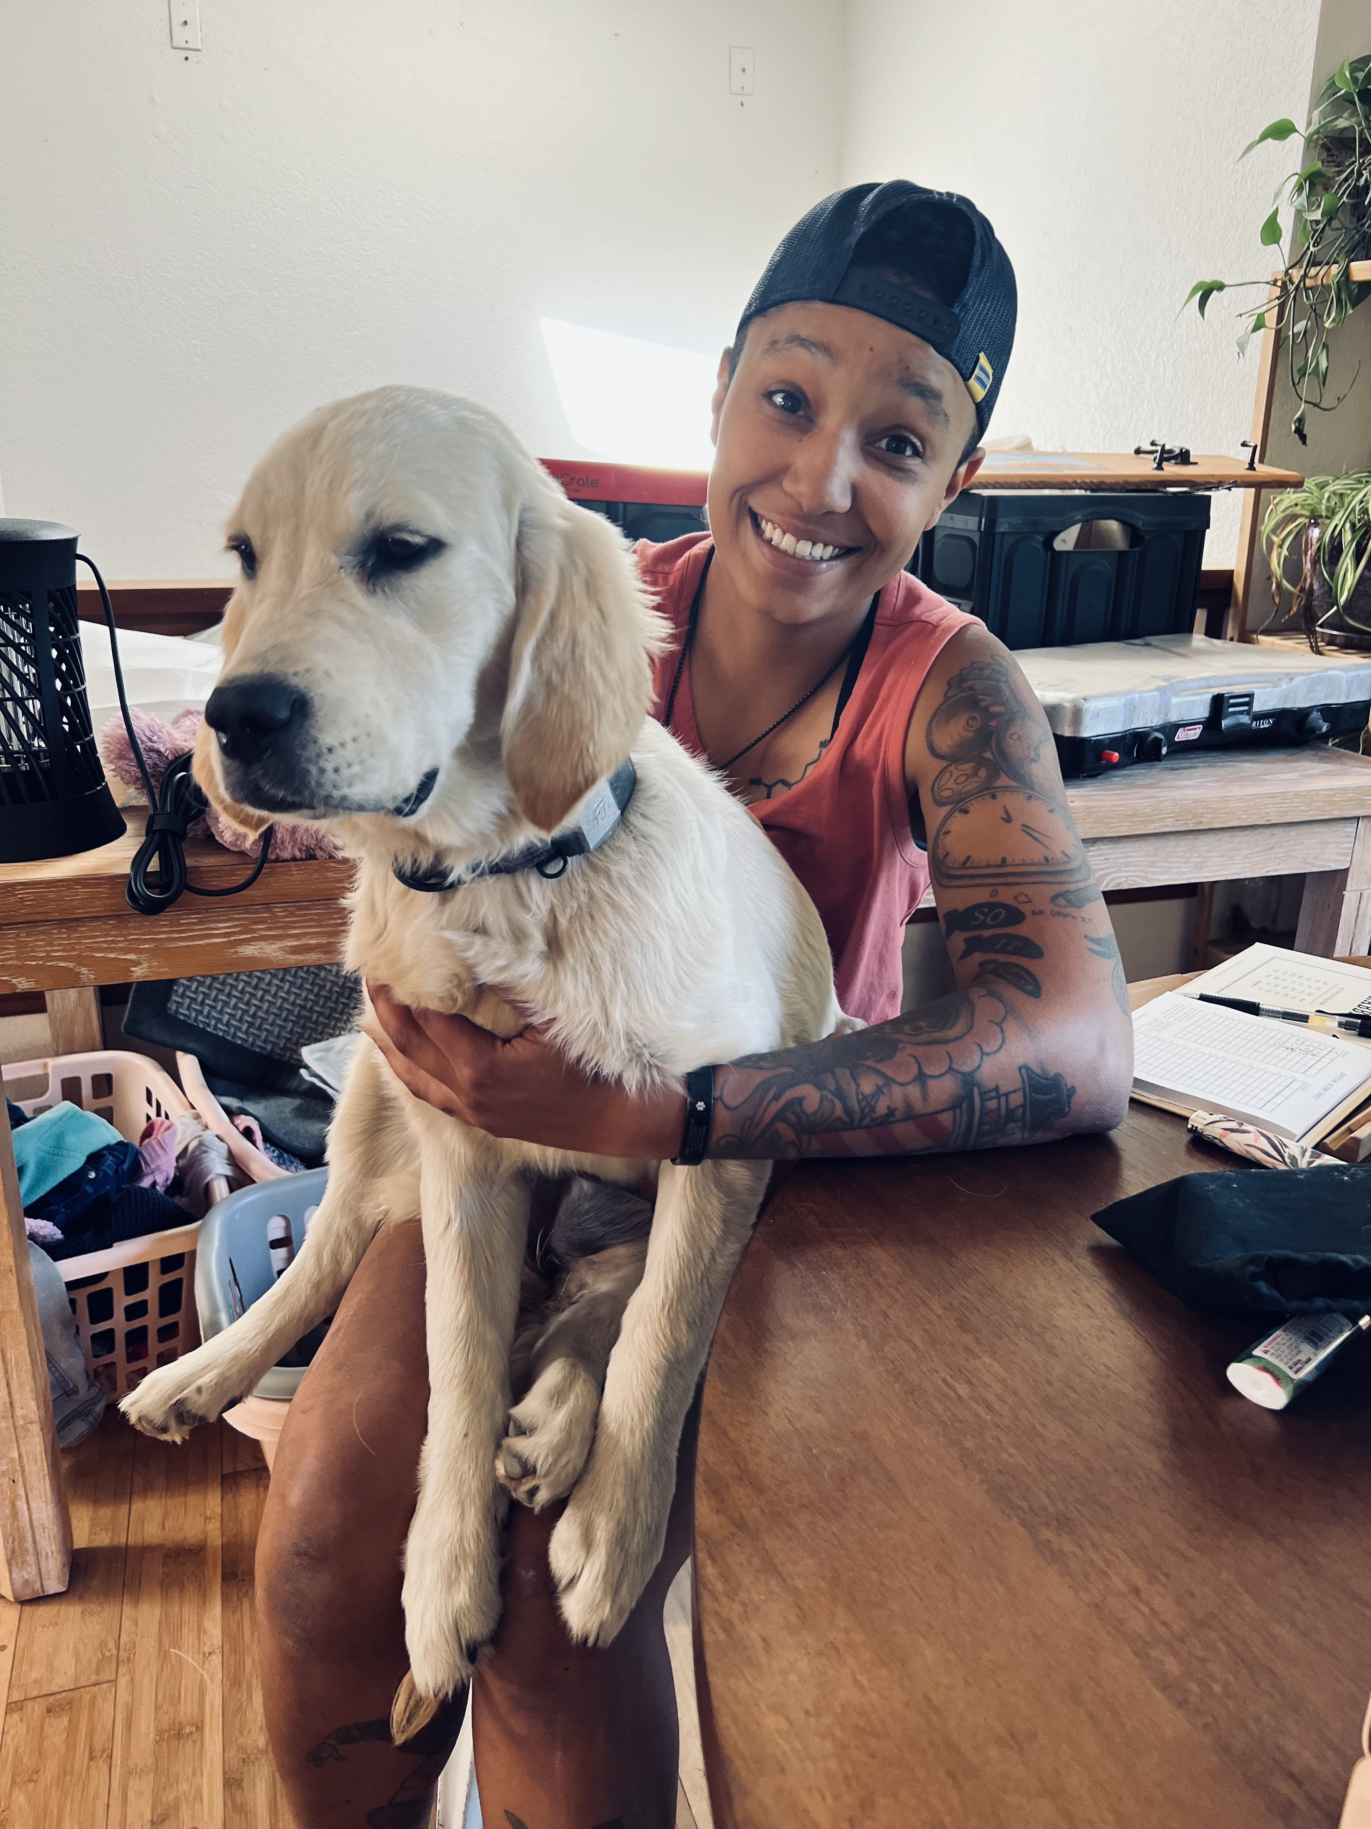
Tavi Morales – ML Success Coordinator
I was at North Middle School in Everett as a Admin Para.
I am excited to learn a new role in our school system. As well as working with a different age group.
I chose to be in education because when I was going through the Arizona school system, I did not have a person of color as a teacher. I experienced a lot of microaggressions from teachers and other students on a daily basis. I want to be here for the kids who have those same, similar, or other rough experiences in school. There for the kids who feel as if no one cares, even though we know that is not true. What motivates me is being the person I needed when I was a student.

Slide 11
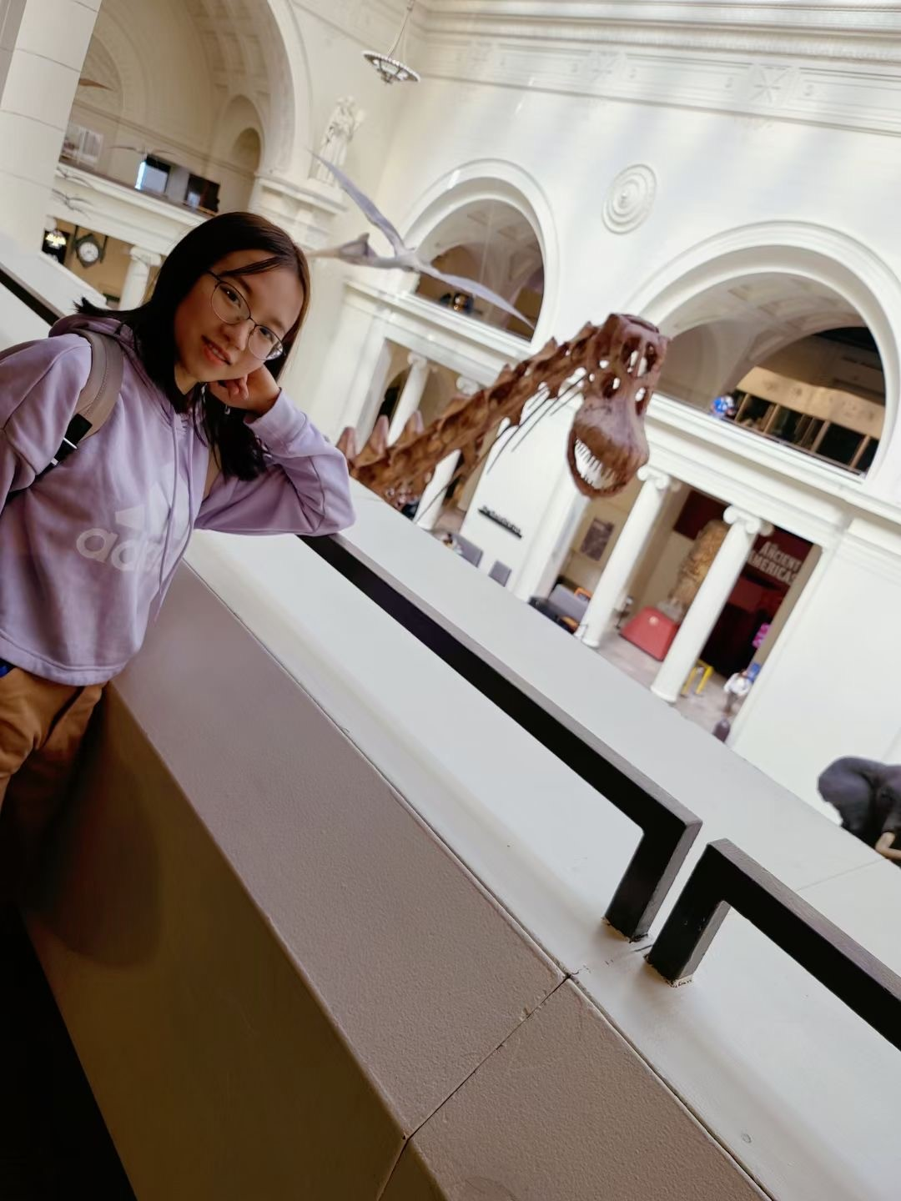
Yiyang Huang – CTE (Computer Science)
I just graduated from Gonzaga. New to teaching.
Teaching computer science is always something I want to do. It’s so important in so many different field. I want to let my student know that programming is not just for nerdy kids who build their own computer in the basement at 12 (geeky kids are more than welcomed in my classroom of course). Jackson is building an IT track for all students in the community. That’s something I really appreciate and want to be a part in.
I always enjoy sharing my knowledge with other people. I have been tutoring for couple of years and finally decide to make it my full-time career. Teaching is a meaningful job with long-lasting impact on so many kids.

Slide 12
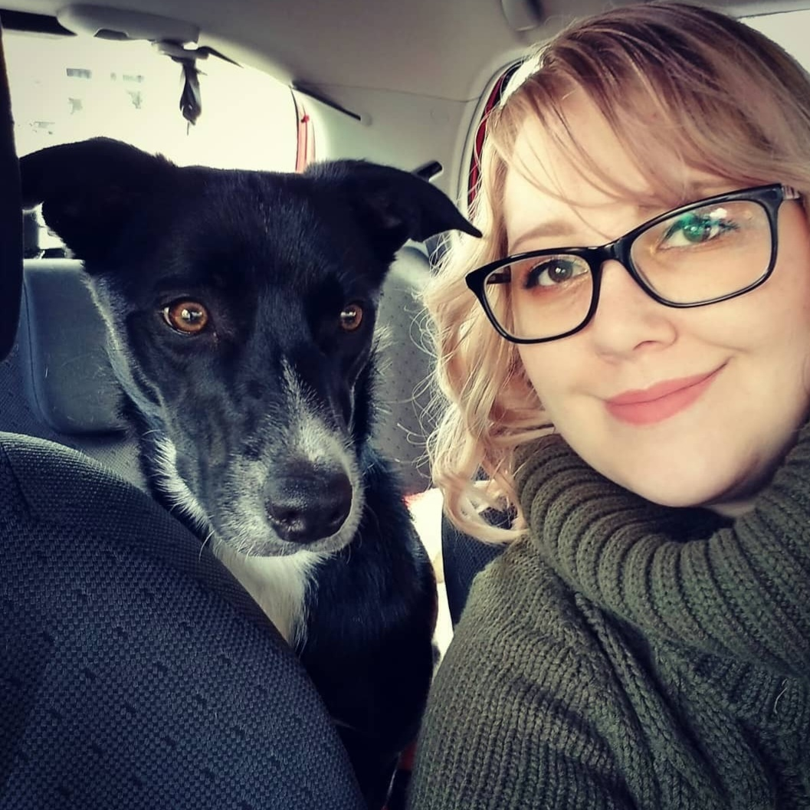
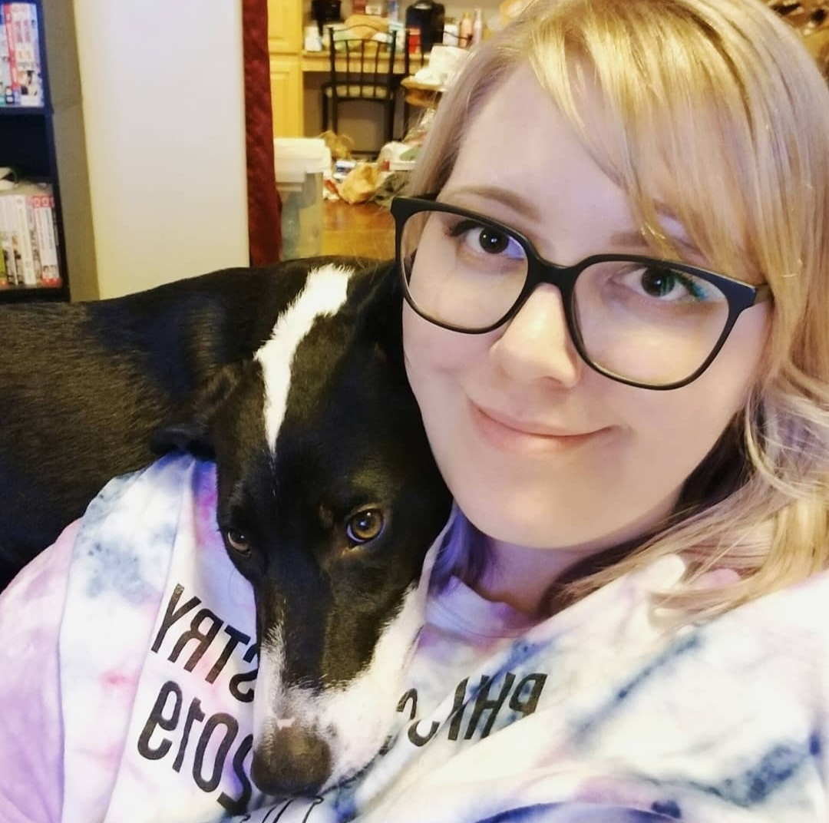
Maggie Jensen - Science
I have worked as a physics and astronomy teacher in Utah for 4 years, and taught physics and 8th grade integrated science. Background in Astrophysics research.
I’m so excited to be teaching physics and astronomy with an amazing department and other physics teachers to collaborate with! (Other subject teachers too!) I’ve always been the only physics teacher at my schools.
I still love stars, don’t get me wrong, but priorities started to change after I started tutoring, TA’ing, and instructing courses and labs. I found that helping students learn, gain confidence, and find joy in science became the reason I get up in the mornings. (Besides my dogs Poppy and Nugget.)

Slide 13
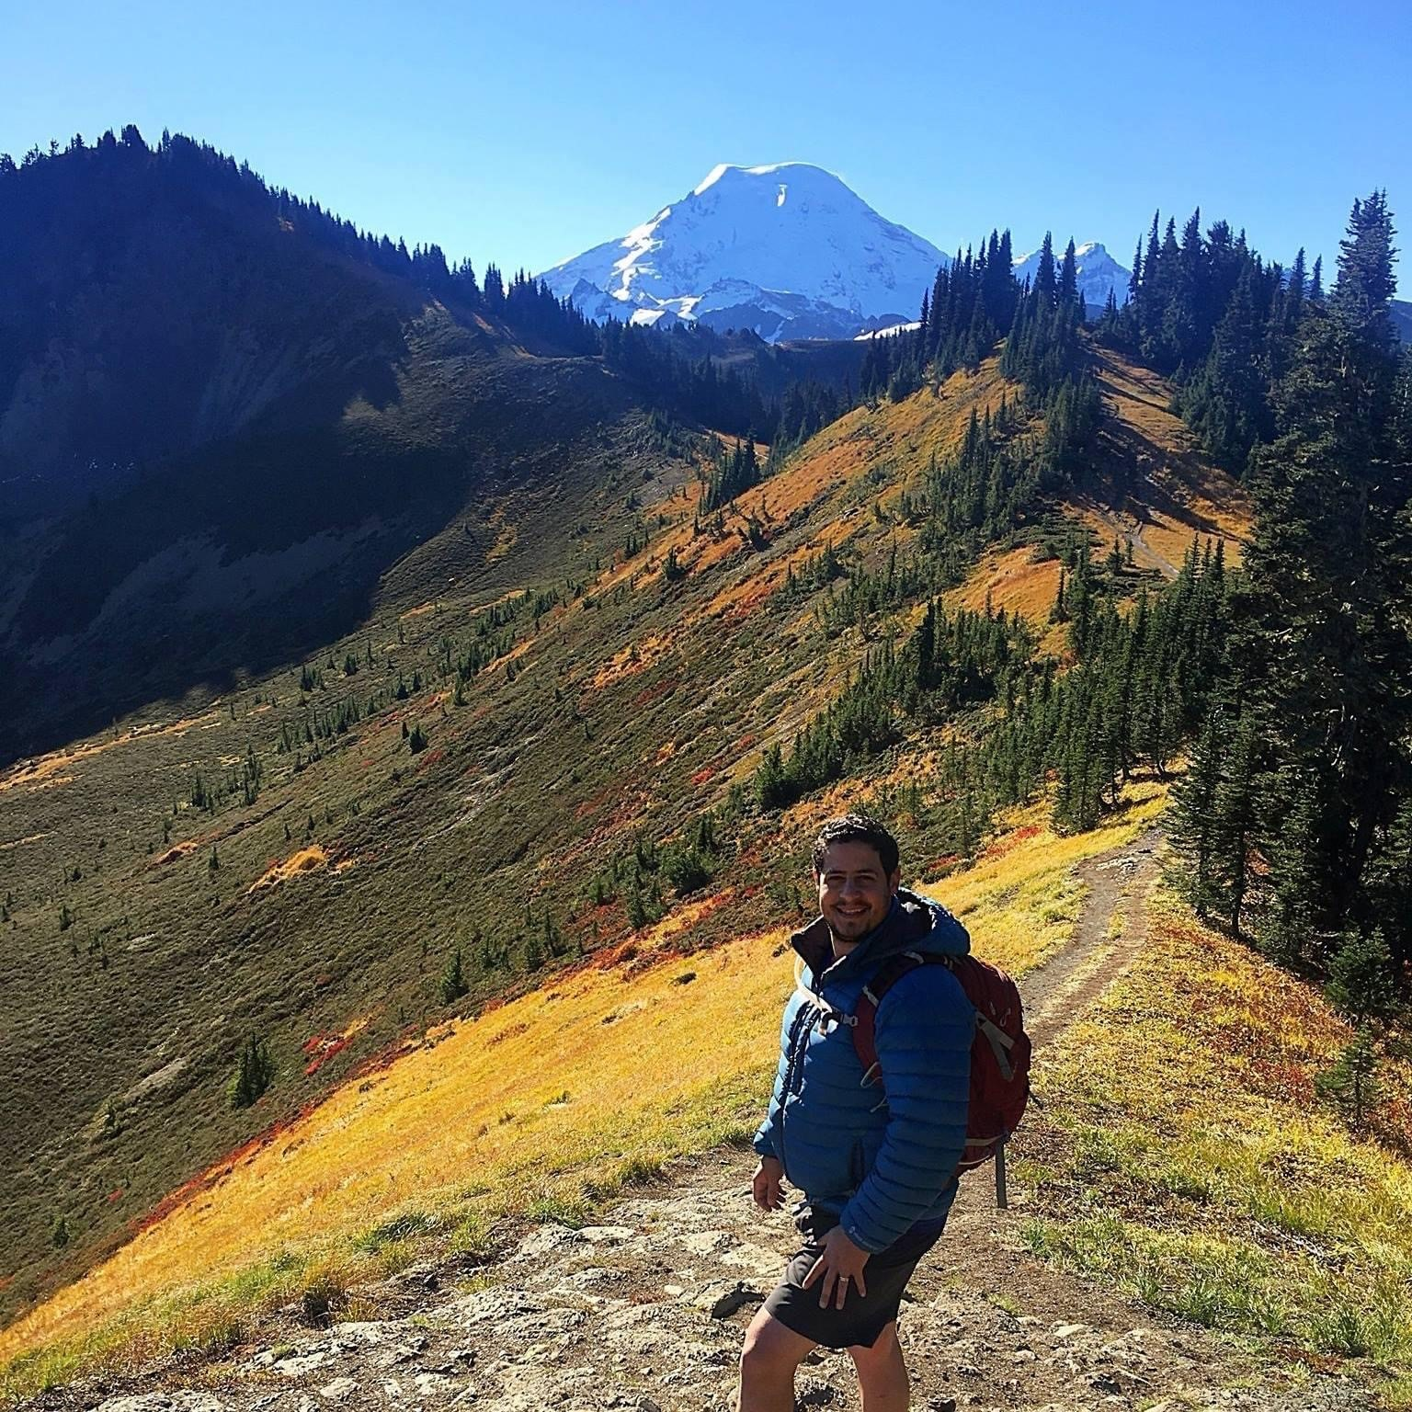
Fady Masoud - Science
I am new to the teaching profession. My previous career was a Civil Engineering.
I’ve had a chance to work at Jackson as a substitute for Gregory Poe at the end of the previous school year. The support I received from the staff in my short time here was beyond what I expected, but above all, the students at Jackson are truly one of a kind and I can’t wait to be a part of their education and success.
My WHY is providing students the absolute best that I have. Their success is what drives me and guides my journey as a teacher.

Slide 14
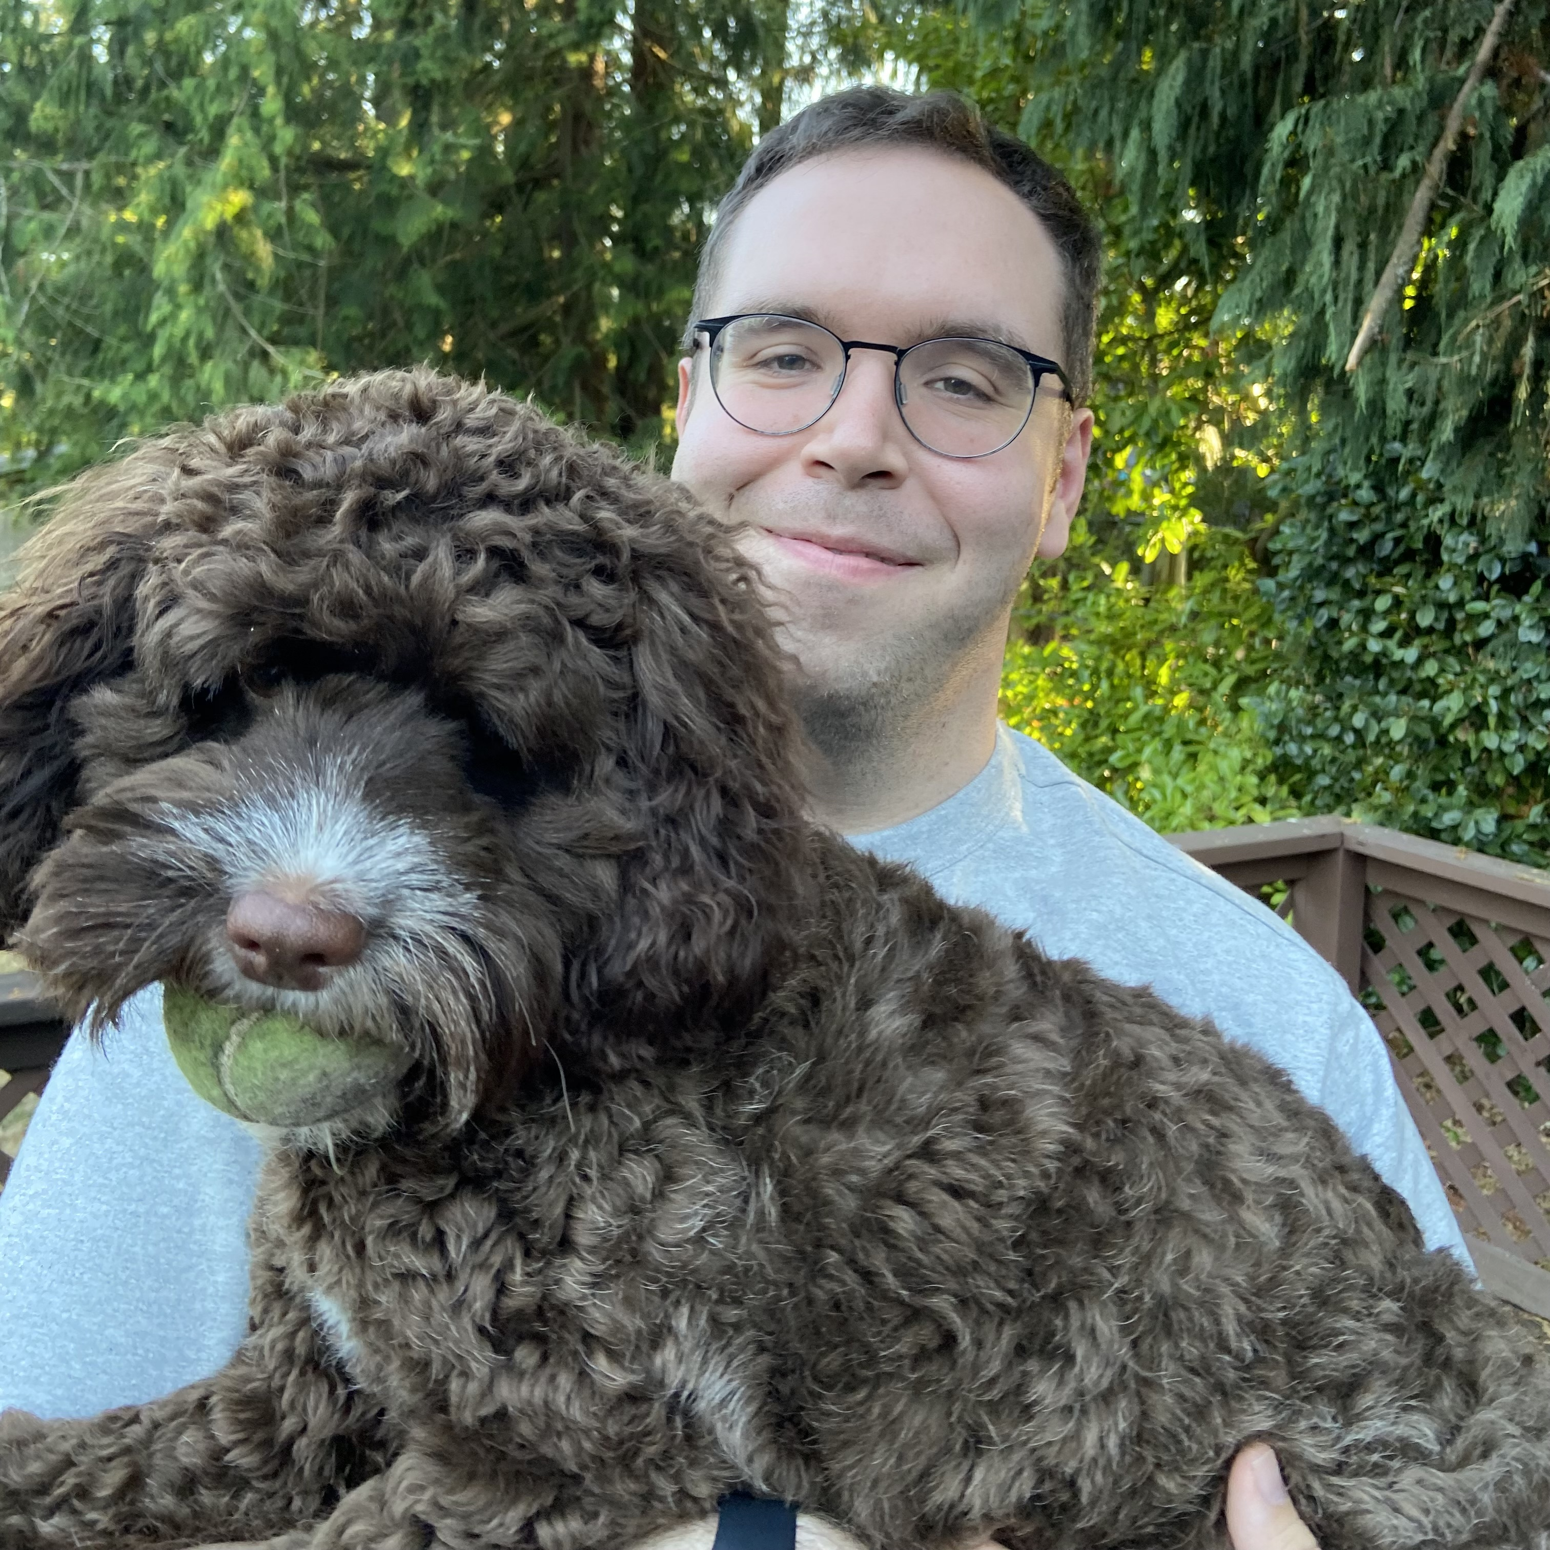
Josh Krueger – School Psychologist
Last year I was at Garfield and Lowell Elementaries, prior to that I worked at Overlake Specialty School.
I have really enjoyed working with high schoolers in the past and have heard great things about the staff and students at JHS.
I love learning about the huge range of experiences and strengths students possess and help put them in positions to use them to meet their goals.

Slide 15
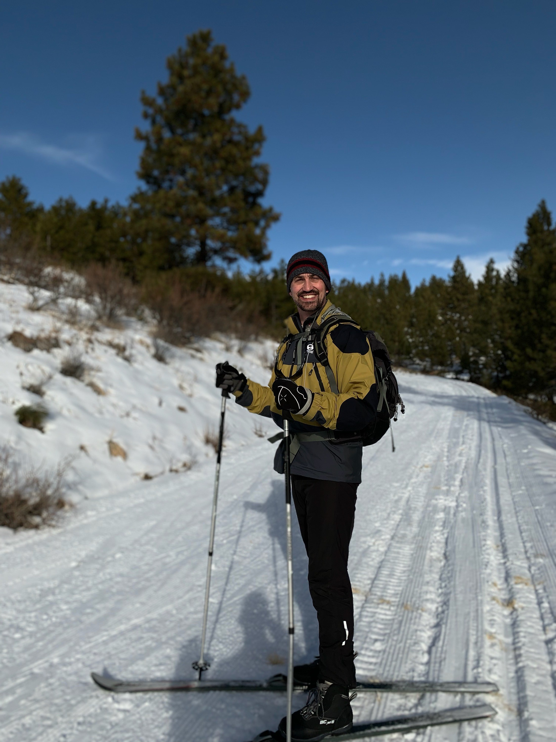
John Lerner - Counseling
I was born on a subtropical island. During my early childhood I lived in the mid-west, so I have deep nostalgia for snowdrifts and fireflies. I was raised in a logging town. I went to the UW for seven years. I have been in education for over 20 years.
I’m a Jackson parent. I’ve been a Mill Creek/South Everett community member for 15 plus years. I am connected to this community. I have collaborated with Jackson high staff at various events for over 10 years, and have loved it. People say Jackson is large. I think it’s a good thing to be part of a large team. So many ideas, so much collaboration. Now, when the timing is right, I couldn’t be happier to be part the community, part of the Pak.
I love solving puzzles, and that is what high school students are. I enjoy helping people when they need help. That’s why I’m here today.

Slide 16
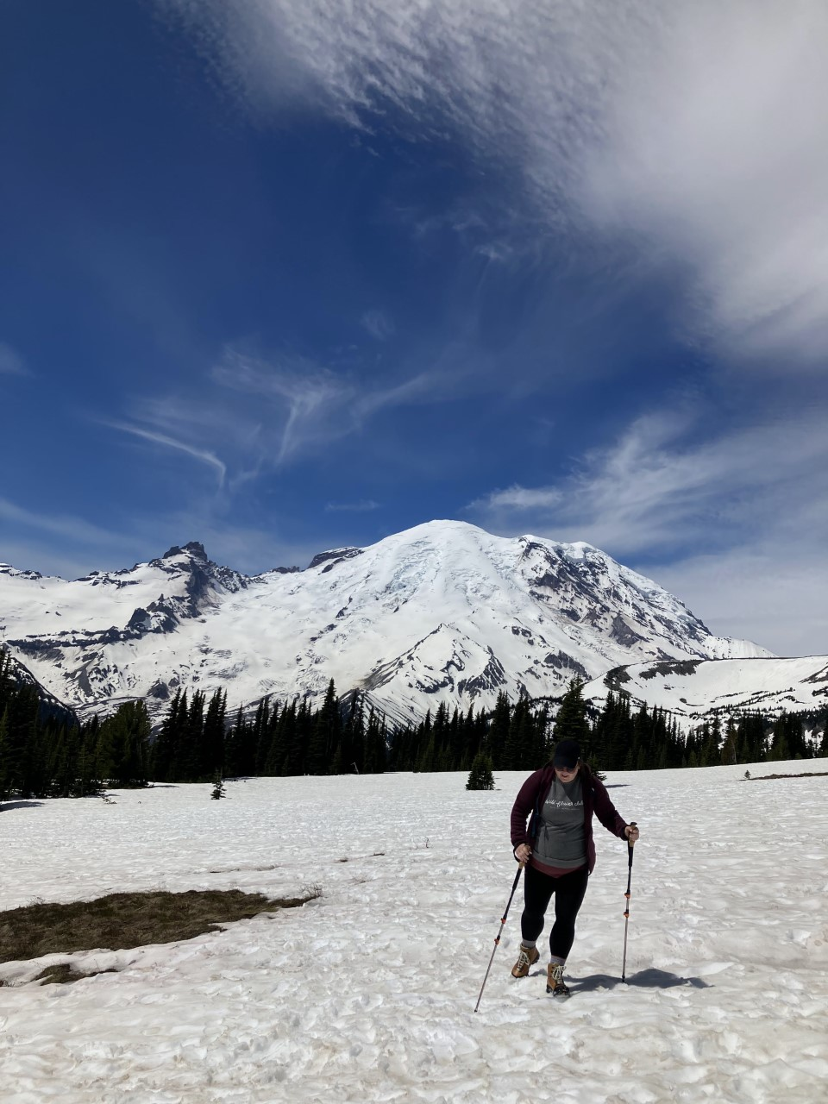
Charlotte Richardson – Speech/Language Pathologist
I came from the Edmonds School District
I love working with high school students because they are preparing to start the next phase of their life. It's such an incredible time to know them
I believe everyone deserves the right to share their thoughts, concerns, joys, and even just random thoughts. I love that I get to help students learn to advocate for themselves and share what's going on in their brains.

Slide 17
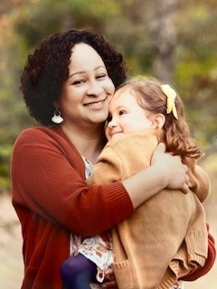
Angela Thomson - Nurse
I started my nursing career at Swedish Hospital in antepartum. I have been with ESD since April 2021. The end of that school year I was on the district COVID team and last school year I was the school nurse for 3 Elementary schools (Jackson, Jefferson and Lowell)
I am excited to join the Jackson team because this is my community. I bought my house just a few blocks away in 2020, and this will eventually be the HS my daughter attends. I have heard great things about Jackson HS and it’s students and staff. I am looking forward to having one school where I can learn and grow my practice and hopefully make a positive impact on those around me.
My number one why is my daughter and being a strong role model for her. I am motivated by my desire to help people and I am excited to work with this age group where they are just starting to grasp and figure out their own medical and body autonomy. I believe that respect, equity, inclusion, and compassion play a huge part in improving and shaping outcomes not only medically but globally and I look forward to aiding in the guidance and understanding of these concepts for JHS.

Slide 18

JHS Student Interns 22-23 (so far)
Teacher | Student | Dates of Placement
Laura Nelson | Neal Iverson | 09/12/22 - 12/08/22
Scott Dyer | Jonathan Kunert | 9/1/2022 - 06/22/23 (share with David Heaton-Bush)
David Heaton-Bush | Jonathan Kunert | 9/1/2022 - 06/22/23 (share with Scott Dyer)
Joel Vincent | David Machado | 08/31/22 - 06/22/23
Leiann Gregg | Karla Rios | 09/01/22 - 06/10/23
Wendy Organ | Jennifer Trybell | 09/21/22 - 12/09/22

